Slide 1
Diy project

Slide 2
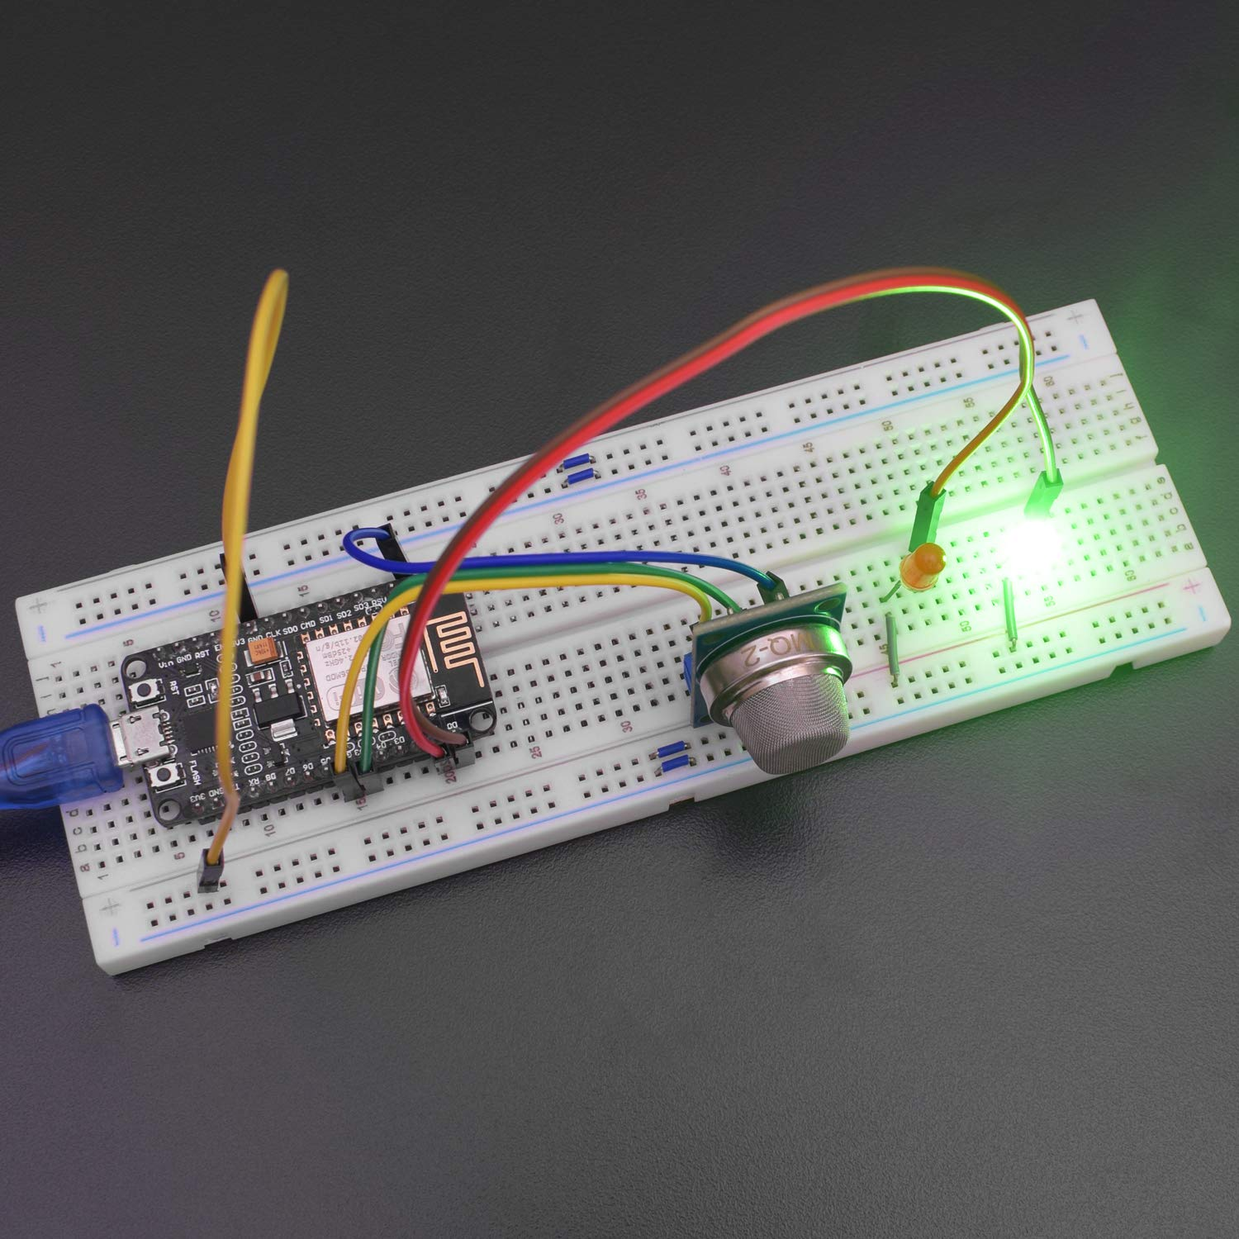
Iot based lpg gas leakage detection system

Slide 3
Krithi bethu 23cs10010 parv makwana 23cs10050 raman Dubey 23ch30026 kaustav Mishra 23cs10030
Team members

Slide 4
Problem statement: In homes, gas leaks from appliances such as stoves, water heaters, or furnaces can lead to asphyxiation or fire outbreaks. Industrial settings face similar dangers, with the added risk of catastrophic accidents due to the presence of highly flammable or toxic gases. Examples of industrial accidents like the Bhopal disaster in 1984, where a gas leak resulted in thousands of fatalities, highlight the urgent need for effective gas detection systems. Symptoms of gas exposure, as stated above, underscore the importance of early detection and mitigation.
problem solving: Implementing a gas detection project using an ESP8266 mcu, and an MQ5 gas sensor can help address these risks by providing early warning systems and remote monitoring capabilities, thereby enhancing safety in both residential and industrial environments.

Slide 5
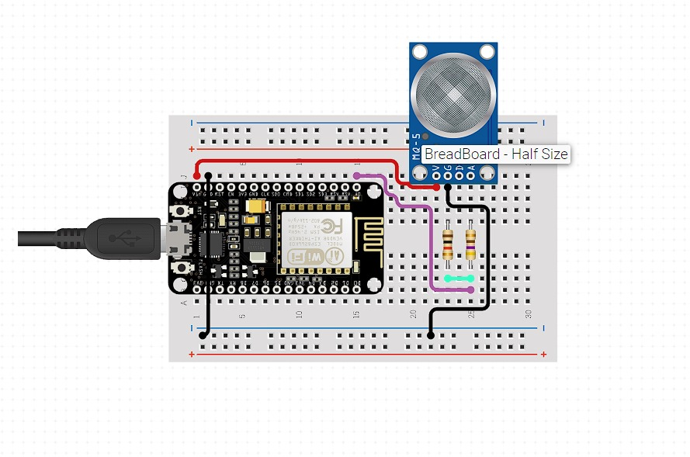
Curcuit diagram

Slide 6
List of components
Mq5 gas sensor
Nodemcu esp8266
Breadboard
Male to Male jumperwires
Resistor 1k ohm
Resistor 470 ohm

Slide 7
Working principle
The Arduino uno is the brain of the project. It simultaneously communicates with the sensor and the wifi module, to send and receive data to wifi and from the mq5 module respectively. The basic flowchart of the algorithm is like this:
The esp starts and begins its communication with the sensor and the wifi.
Then the ESP gets information regarding the concentration of gas from mq5 sensor.
If the sensor reading is greater than a certain value, an alarm/alert will be sent through the wifi to a webserver.
An physical alarm system can also be implemented into the project for sudden alarm, even if the wifi system fails to transcend data.

Slide 8
Work distribution
Programming-krithi bethu and kaustav mishra
Physical assembly of components- raman dubey and parv makwana

Slide 9
thank you

